Slide 1
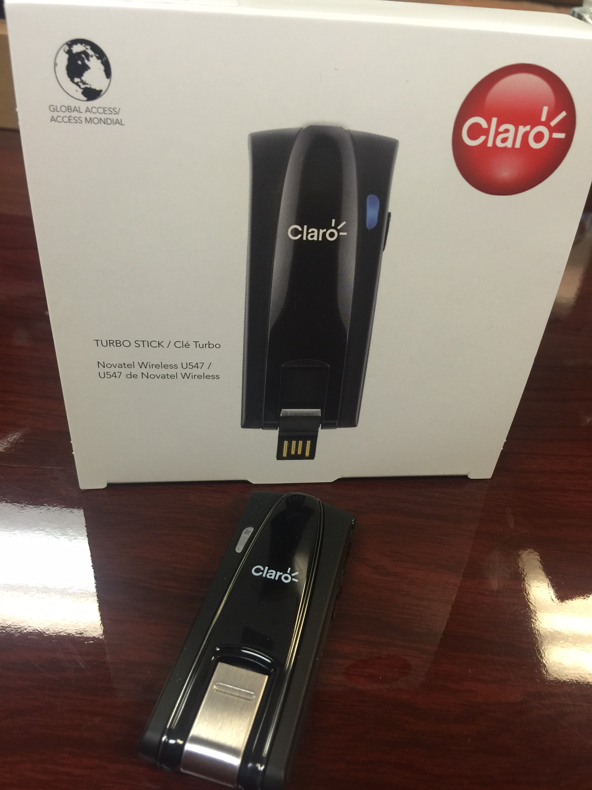

MC547
Specifications:
MobiLink™ Connection Manager
GSM Quad band
3G bands: 850/1900/2100 Mhz
HSPA+. DL42Mbps/ UL5.76Mbps
Dual Carrier support
FCC/PTCRB/GCF Certified
MicroSD Slot (Up to 32 GB)
Support Windows 7/Mac/Linux
Dimensions: 82*30*13mm
Weight: 30g

